Slide 1
Computational Complexity

Slide 2
Introduction
Computational problems can be of two types:
that can be solved by algorithms, and that cannot
Unfortunately, many problems, although in principle solvable, cannot be solved in any practical sense by computers due to excessive time/space requirements
Time Complexity and Space Complexity

Slide 3
TRAVELING SALESMAN PROBLEM
Suppose that it is your task to schedule the visits of a travelling sales representative to 10 regional offices. You are given a map with the 10 cities and distances in miles, and you are asked to produce the itinerary that minimizes the total distance traversed.
Theoretically, the problem is certainly solvable

Slide 4
TRAVELING SALESMAN PROBLEM
If there are n cities to visit, the number of possible itineraries is finite - (n-1)!
For 10 cities, we would have to examine 9! = 362,880 itineraries
For 40 cities, number of itineraries = 39! which is larger than 10⁴⁵
Even if we could examine 10¹⁵ tours per second the required time for completing this calculation would be several billion lifetimes of the universe!!

Slide 5
Polynomial Bound
Exponential growth of time requirements
function (n - 1)! grows even faster than 2^{n}
In order to have a “practically feasible algorithm” we must limit our computational devices to only run for a number of steps that is bounded by a polynomial in the length of the input

Slide 6
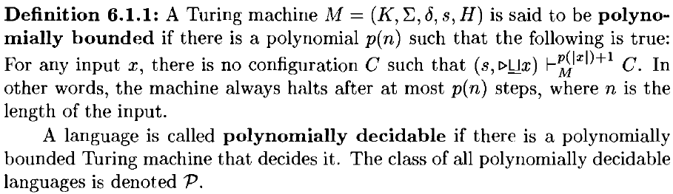
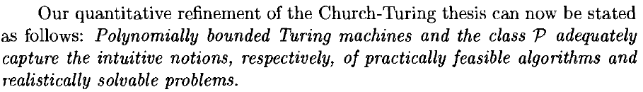
The Class P

Slide 7

The Class P

Slide 8

Some Examples
REACHABILITY is in P
A graph that contains such a path is called Eulerian or unicursal.

Slide 9
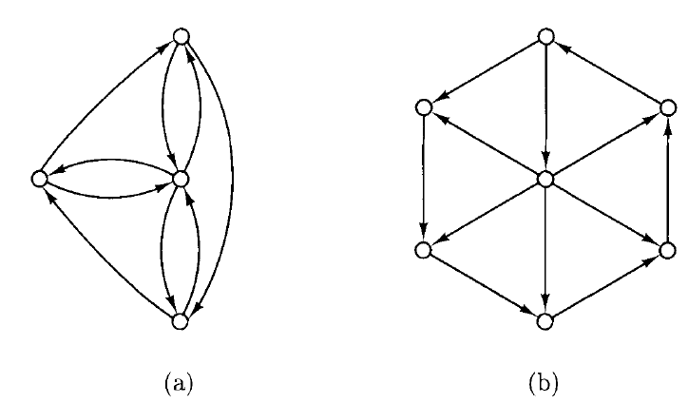
Eulerian and Hamiltonian Graphs

Slide 10
Eulerian and Hamiltonian Graphs
EULER CYCLE is in P
After one and a half centuries of scrutiny by many talented mathematicians, no one has discovered a polynomial algorithm for HAMILTON CYCLE.

Slide 11
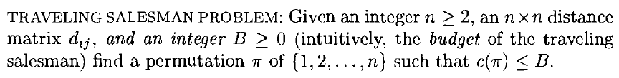


Optimization Problems
(no polynomial-time algorithm)
(a set of nodes covers an edge if it contains at least one endpoint of the edge)

Slide 12
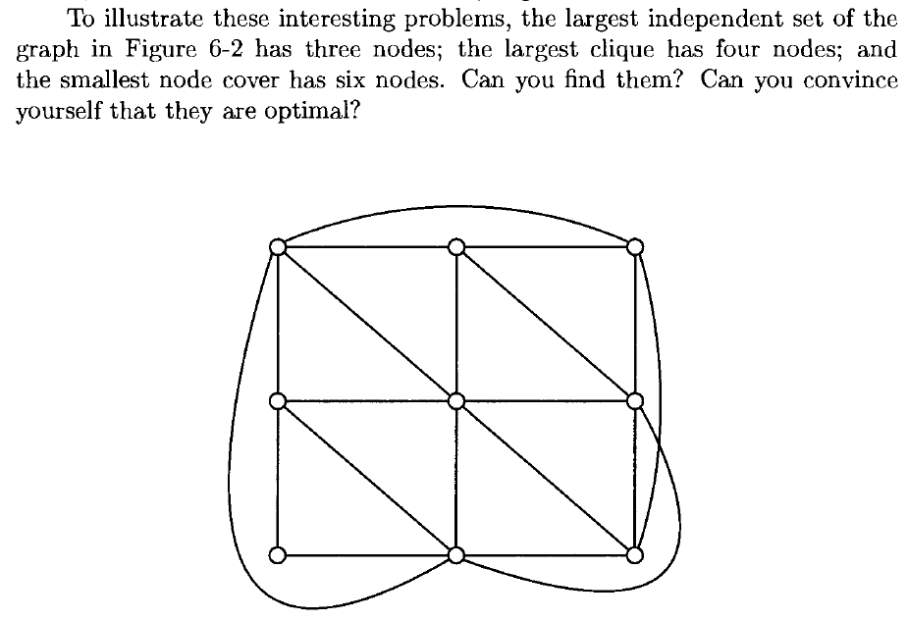
Examples

Slide 13
Examples
Not polynomial in the length of the input

Slide 14
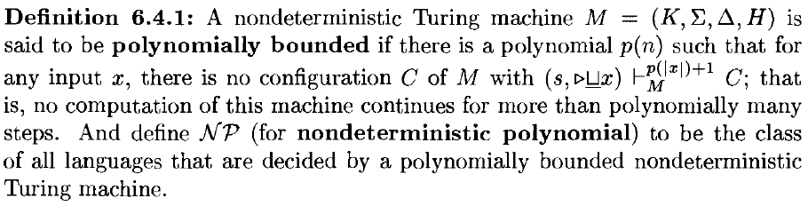
The Class NP
The TRAVELING SALESMAN PROBLEM is in class NP
INDEPENDENT SET, HAMILTON CYCLE, and PARTITION are also in NP.

Slide 15
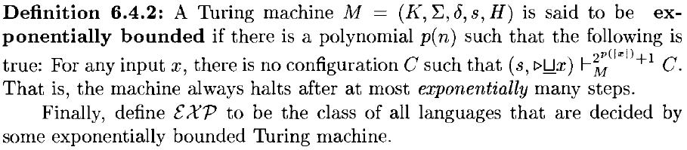

The Class EXP
Whether P = NP is a question of central importance to complexity theory that is presently unresolved
Although we suspect that both of the inclusions displayed above are proper, all we can currently prove is that at least one of them is proper -and we do not know which !

Slide 16
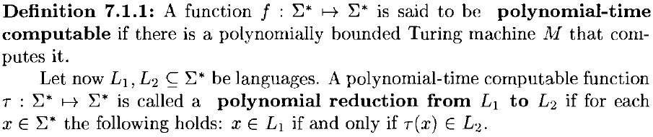
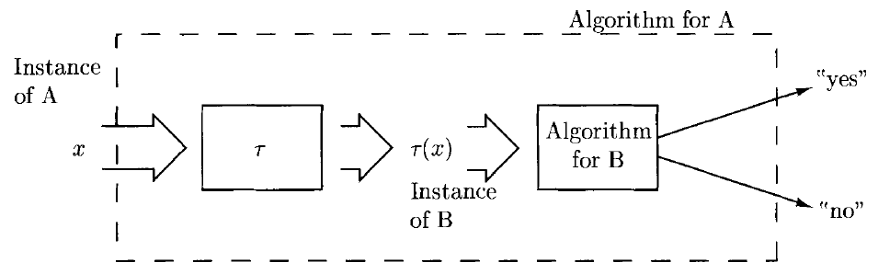
Polynomial-time Reductions

Slide 17
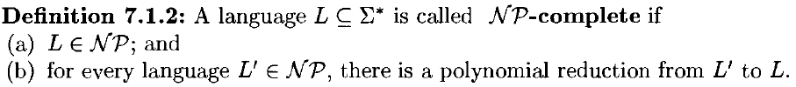
NP-complete Problem
Examples

Slide 18
Halt the Course here!!
Thank You !

